Slide 1
Competing on Analytics
Group 7:
Abhitej Kodali
Balaji Katakam
Divyaj Podar
Tej Modi
Twinkle Ghatoriya
Niyati Shah
Notes:
1-4 Divyaj
5-7 Twinkle
8-10 Niyati
11-14 Balaji
15-19 Abhitej
20-23 Tej

Slide 2
Deliverables
Key Strategies
Concepts
Lessons learned in the paper
Notes:
Divyaj

Slide 3
Analytics
Analytics is the discovery, interpretation, and communication of meaningful patterns in data. Especially valuable in areas rich with recorded information, analytics relies on the simultaneous application of statistics, computer programming and operations research to quantify performance.
Notes:
Analytics is the study of the data to understand customer behaviour and potential trends so as to gain a competitive advantage in the market with similar products and technologies

Slide 4
Killer apps
A killer app is a:
Feature
Function
Application
of a new technology or product that is presented as indispensable or much superior to their rival products
Companies which began with killer apps were:
American Airlines - Electronic Reservations System
Otis Elevators - Predictive Maintenance System
American Hospital Supply - Online Ordering System
Notes:
Divyaj

Slide 5
Transition from killer apps
Companies are transitioning from killer apps based strategy to industrial strength analytics
Focus of the killer app has been
On one area
To create competitive advantage
Reasons for transitioning to analytics
Most firms offer similar products and use comparable technologies
Last remaining way to differentiate the organization amongst other competitor
Early adopters and dominator of analytics are
Amazon
Capital One
And Boston Red Sox
Notes:
Twinkle

Slide 6
Organization who don’t adopt analytics | Organizations who adopt analytics
Know -what products their customers want | Know - what products their customers want - what prices those customers will pay - how many items each will buy in a lifetime - what triggers will make the people buy more
Know - compensation costs and the turnover rates | Know - compensation costs and the turnover rates - how much the employee personnel contribute - how salary is related to individual’s performance
Know - when the inventories are running low | Know - when the inventories are running low Predict - problems with the demand and supply chains Achieve -low rates of inventory and high rates of perfect order
Notes:
Twinkle

Slide 7
Key attributes amongst analytical competitors
Wide spread use of modeling and optimization
Enterprise approach
Senior executives advocates
Notes:
Twinkle

Slide 8
Wide spread use of modeling and optimization
Companies should use predictive modeling instead of basic statistics to identify profitable customers and the ones with the most profit potential and the ones likely to cancel their account.
Use pool data which is generated
In-house
And, data acquired from outside sources
For a comprehensive understanding of their customers
Use sophisticated experiments to measure the overall impact of the strategies and then apply the strategy if it provides positive results
Companies using this strategy are:
Marriott
Progressive
Capital one
Notes:
Twinkle

Slide 9
Marriott International
Successfully trying to refine the system since 20 years to establish the optimal price for the guest rooms.
Far more ambitious now
Introduction of the Total Hotel Optimization program:
Expand quantitative expertise to areas such as conference facilities and catering
Made related tools available to the owners of hotel and the property revenue manager
Optimize offerings to frequent customers
Assess the reasons of customers defecting to the competitors
Not just dependent on the analytics:
Marriott has given the power to overrule the recommendations provided by the system in case there are certain factors that cannot be predicted by it
Revenue recognition model created by Marriott
Calculates actual revenues as a percentage of the optimal rates that could have been charged
The model shows the growth of actual revenue from 83% to 91%
Notes:
Niyati

Slide 10
Progressive
Uses widely available insurance industry data
Company creates a narrow groups of customers
Performs regression analysis and identifies the factors that most closely correlates with the losses that the narrow group endangers
Example of a narrow group:
Motorcycle riders - ages 30 and above - with college education - good credit score - no accidents
Sets different prices for different groups
Enables profits across a portfolio of groups
Able to insure high-risk categories which other insurers reject without trying to understand the data
Notes:
Niyati

Slide 11
Enterprise approach
Many business functions such as marketing, human resources which have earlier depended on the art rather than the science can be improved with the help of sophisticated quantitative techniques
Unlike the killer app which focuses on one particular area, analytics to be successful should focus on many parts of the business.
Now analytics is not only being used by the enterprise but also by the customers and the suppliers
Examples of enterprise approach are:
UPS
Barclays Bank
Notes:
Balaji
There are many business functions like marketing and HR who depend on art rather than a well thought reasoned quantitative technique.
Whereas oncomparing the killer app with analytics which focuses on one particular area, analytics to be successful should focus on many parts of the business.
Analytics is being used by the enterprise, customers and the suppliers

Slide 12
UPS
Evolution from targeted analytics to comprehensive analytics
Ups uses statistical skill to:
Track the movement of the packages
Anticipate and influence the actions of the people
UPS can understand the problems faced by the customers and identifying the sources of the problem
UPS Customer Intelligence Group is able to accurately predict customer defections by examining
Patterns
Complaints
When the data points to a potential customer who might leave, the customer service contacts him and resolves the problem
Notes:
Balaji

Slide 13
Senior executives advocates
Requires leaders who are passionate about the quantitative approach
Ideally the key person to advocate should be the CEO
CEO’s leading the analytical charge require
Appreciation with the subject
Familiarity with the subject
No need for the leaders to have statistical background, but they need to understand the quantitative methods to recognize the models limitations
When in need of help to grasp the quantitative techniques, CEO’s can turn to the experts who can are able to understand the business and how the analytics can be applied
Notes:
Balaji

Slide 14
Popular executives who advocates the use of analytics
Loveman of Harrah’s
Jeff Bezos of Amazon
Rich Fairbank of Capital One
Former CEO Barry Beracha
Notes:
Balaji

Slide 15
Requirements for better competitive advantage in the field or analytics
The right focus
The right culture
The right people
The right technology
Notes:
Abitej

Slide 16
The right focus
Although analytics is enterprise-wise approach, they must choose where to direct resource-intensive efforts
Harrah’s has aimed much of its analytical activity at
increasing customer loyalty
Increasing customer service
Related areas like pricing and promotions
UPS focuses on logistics to customers in the interest of superior service
Notes:
Abitej

Slide 17
The right culture
Analytical competitors must instill an organization-wide respect to measure, test, and evaluate quantitative decisions
Employees are made to base decisions on hard facts
There are instances when there is not enough time to go through extensive analysis and the decision to change something must be quick.
For example; Jeff Bezos who prefers rigorous analysis before rolling out new features couldn’t wait to introduce the company’s search-inside-the-book offering. He trusted his instincts and introduced it any way and it proved to be a popular feature.
Notes:
abitej

Slide 18
The right people
Analytical firms need to hire analytical people
Amazon hired Gang Yu, a professor who is world’s leading authority on optimization analytics for its global supply chain
Capital One employed several analysts to conduct quantitative experiments, and with the results in hands, design the credit card and other financial offers
Good analyst must have the ability to express complex ideas in simple terms and have relationship skills to interact well with the decision makers.
Organization can outsource work to other countries in case of stand-alone problem.
In case of iterative discussion with business decision makers is required, distance can become a major barrier
Notes:
abitej

Slide 19
The right technology
Competing on analytics means competing on technology
An analytics organization may not need its own supercomputer but will definitely need
A data strategy
Business Intelligence Software
Computer Hardware
Notes:
Abitej

Slide 20
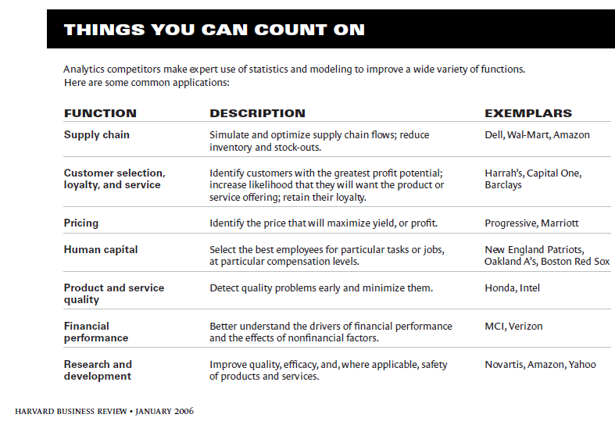
Notes:
Tej

Slide 21
Barclays Bank’s journey to embrace analytics
Spent 5 years executing its plan to apply analytics for the marketing of its credit cards and other financial products
Had to make process changes in almost every aspect of its business which is
Setting credit limits
Servicing accounts
Controlling fraud
Cross selling and so on.
Had to make process changes in technical side as well, it had to:
Integrate data on 10 million Barclaycard customers
Improve the quality of the data
Build up systems to step up data collection and analysis
Notes:
Tej

Slide 22
A long road ahead
Most amount of time and expense to become an analytical competitor will be devoted to
Refine the systems producing transactional data
Make data available in warehouses
Selecting and implementing analytical software
Assembling hardware and communications environment
Extensive training of existing employees
Hiring of new personnel.
UPS has been collecting data for 6-7 years but was only usable since the last 3 years as they needed the experience and the test result before implementing it on the large scale
These are some of the reasons that proves that implementing analytics is a long journey, but often a fruitful one
Thus, some suggest that organizations should keep the managers in their jobs for longer duration because of the time it takes to master the quantitative approaches of the business
Notes:
Tej

Slide 23
Thank you
Notes:
Tej

